Slide 1
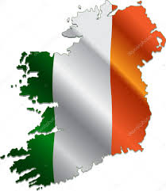
Tourist attractions in Ireland
Author Martyna Szpot kl. 2G

Slide 2
Plan of presentation
1. Initial slide
2. Plan of presentation
3. Rock of Cashel
4. Kylemore Abbey
5. Library of Trinity College Dublin
6. Newgrange
7. Blarney Castle
8. Cliffs of Moher
9. Mizen Head
10. Bibliography

Slide 3
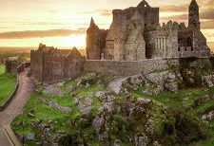
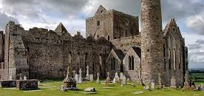
Rock of Cashel
Rock of Cashel is a historic site located at Cashel in Country Tippeary.
According to local legends, the Rock of Cashel originated in the Devil's Bit when St. Patrick banished Satan from a cave. In result the Rock landed in Cashel.
The word Cashel is English version of Irish expression caiseal which means stronghold.

Slide 4
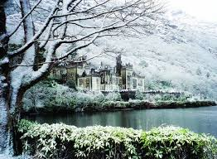
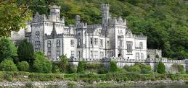
Kylemore Abbey
Kylemore Abbey is a Benedictine monastery in Connemara in County Galway.
Kylemore Castle was built in 1868 as a private home for the family of Mitchell Henry who was a wealthy doctor from London. His family was involved in textile manufacturing in Manchester.

Slide 5
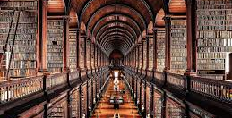
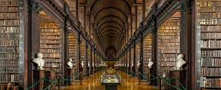
Library of Trinity College Dublin
Library of Trinity College Dublin serves Trinity College and the University of Dublin.
The Library is the permanent home to the Brian Boru harp, a copy of 1916 Proclamation of the Irish Republic as well as the Book of Kells.
The main chamber of the Old Library has 65-metres long. It was built between 1712 and 1732.
There are housed 200,000 of the Library's oldest books.

Slide 6
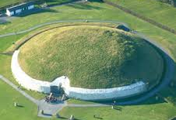
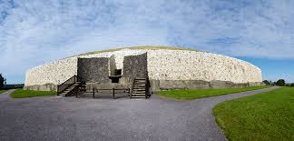
Newgrange
Newgrange is a prehistoric monument in Cunty Meath.
The monument was built by Neolithic people who were native agriculturalists lived off growing crops and raising animals such as cattle in the area of their settlements.
Many archaeologists believed that the monument had religious significance of some sort or another. Either of them consider it as a place of worship for a "cult of the dead" or astronomically-based faith.

Slide 7
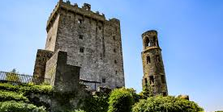
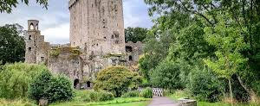
Blarney Castle
Blarney Castle is a medieval stronghold.
This castle is dates from before 1200.
It was destroyed in 1446 subsequently rebuilt by Cormac Láidir MacCarthy.
The castle is now a partial ruin with some accessible rooms and battlements.
The castle is surrounded by extensive gardens.

Slide 8
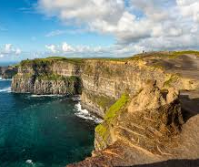
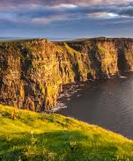
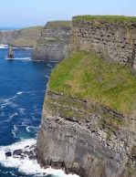
Cliffs of Moher
Cllifs of Moher are sea cliffs located at the southwestern edge of the Burren region in County Clare.
The cliffs take their name from an old promontory fort called Mothar or Moher.
The cliffs are one of the most popular tourist attraction in Ireland.

Slide 9
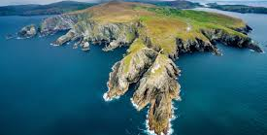
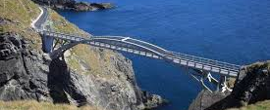
Mizen Head
Mizen Head is one of the extreme points of the island. It is also a major tourist attraction, noted for its dramatic cliff scenery.
Mizen Head was the last part of earth which was seen by passengers of Titanic.

Slide 10
Bibliography
https://images.app.goo.gl/warufjotF36HK6jF7
https://images.app.goo.gl/gNinmhh8MYLbrZzv6
https://images.app.goo.gl/H4joPZwiucMsoxd86
https://images.app.goo.gl/hsKjQRE6jfZJT74v9
https://images.app.goo.gl/izKr49kZa56iv3GfA
https://images.app.goo.gl/kYE39QfsjYAvCYni7
https://images.app.goo.gl/9o4pmvTKeNqgXaMC7
https://images.app.goo.gl/aHP3CrqaR1xpZoNN7
https://images.app.goo.gl/BJEkRz5e1UwdfCsL6
https://images.app.goo.gl/474p5hjugspWSBEBA
https://images.app.goo.gl/cXMTzYUiTYFpFUrr7
https://en.wikipedia.org/wiki/Newgrange
https://en.wikipedia.org/wiki/Rock_of_Cashel
https://images.app.goo.gl/jyK3Dxvuv2v3Uu5A7
https://images.app.goo.gl/488SdkCbqkKrq48Q8
https://images.app.goo.gl/3xAqFQDqSnTjVQpE6
https://en.wikipedia.org/wiki/Kylemore_Abbey
https://en.wikipedia.org/wiki/Library_of_Trinity_College_Dublin
https://images.app.goo.gl/5vBTNHLCMaPxSAqZ6
https://images.app.goo.gl/b8rGpe3b8WZ1iFRP8
https://images.app.goo.gl/JM4RWtKMsMLAHo1H8
https://images.app.goo.gl/ZDytQar24H29YrP8A
https://en.wikipedia.org/wiki/Blarney_Castle
https://images.app.goo.gl/TTVu4TNs7SGyeFpu8
https://images.app.goo.gl/A5s8ANhfUcvg7e2k6
https://en.wikipedia.org/wiki/Cliffs_of_Moher

